Slide 1
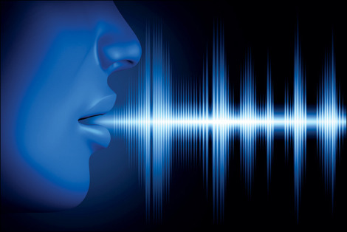
MACHINE LEARNING BASED SPEECH EMOTION RECOGNITION

Slide 2
CONTENTS
INTRODUCTION
PROBLEM STATEMENT
PROPOSED MODEL
SOFTWARE REQUIREMENTS
METHODOLOGY
RESULTS AND DISCUSSIONS
ADVANTAGES
APPLICATIONS
FUTURE SCOPE

Slide 3

INTRODUCTION
Communication is an important capability, not only based on the linguistic part but also based on the emotional part. Emotions control your thinking, behaviour and actions.
Speech emotion recognition is a technology that extracts features from the speech signals and contrasts and analyses the characteristic parameters and gives the emotion.

Slide 4

PROBLEM STATEMENT
We may not be able to convey all our thoughts through speech, then emotions play their role in exhibiting one's feelings. The detection and analysis of the same is of vital importance in today’s digital world of remote communication.

Slide 5
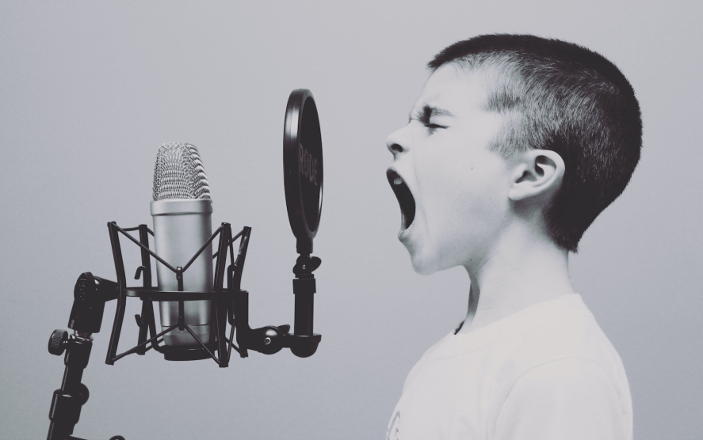
PROPOSED MODEL
There are three classes of features in a speech namely- the lexical features, the visual features, the acoustic features.
Analysis on the acoustic features can be done in real-time as we just need the audio data for accomplishing our task. Hence, we choose to analyze the acoustic features in this work.
The representation of emotions can be done in two ways- Discrete Classification, Dimensional Representation.

Slide 6
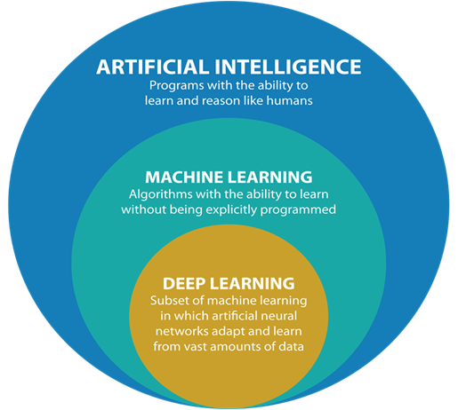
SOFTWARE REQUIREMENTS
Python
Librosa
Matplotlib
NumPy
Pandas
Keras
Scikit-learn

Slide 7
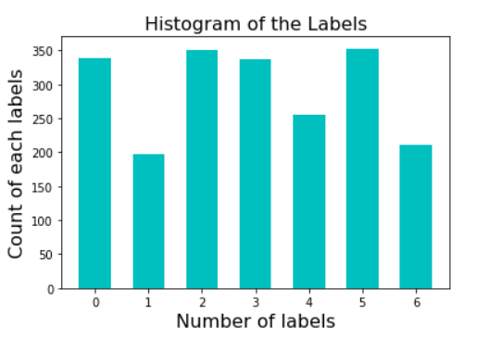
The complete dataset is split in the ratio 0.8 as training and 0.2 as testing datasets.
Dataset samples : 2556
Training samples: 2044
Testing samples : 512

Slide 8
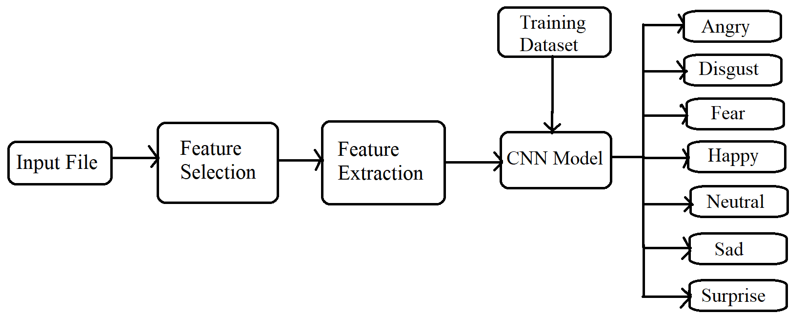
METHODOLOGY
ALGORITHM

Slide 9
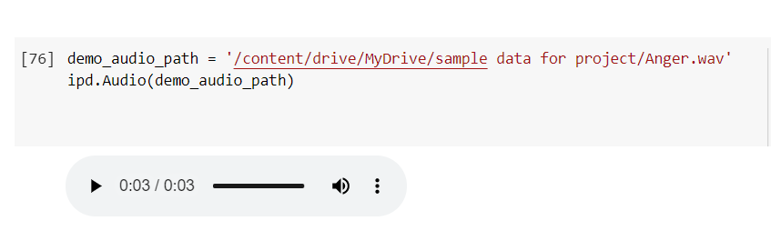
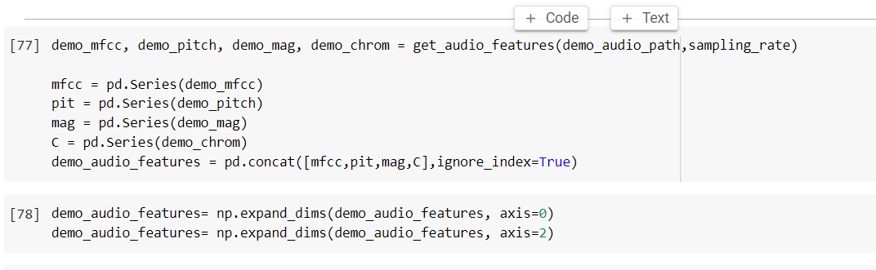
RESULTS AND DISCUSSIONS

Slide 10
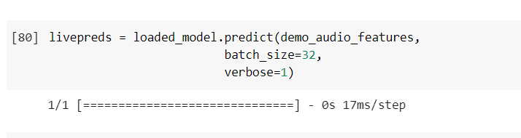
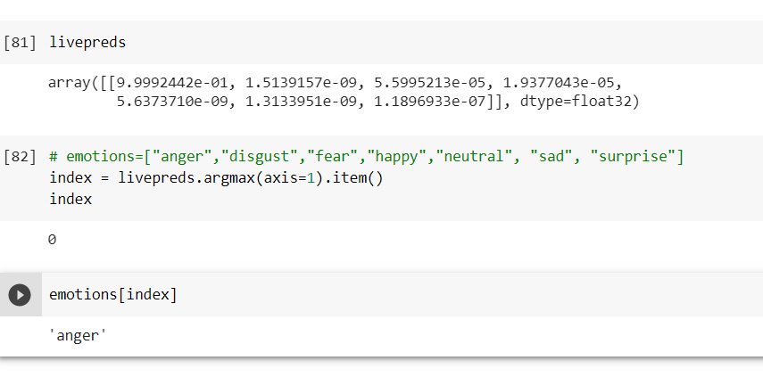

Slide 11
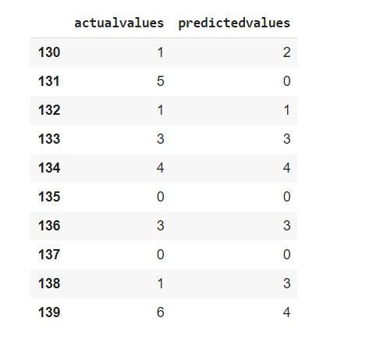
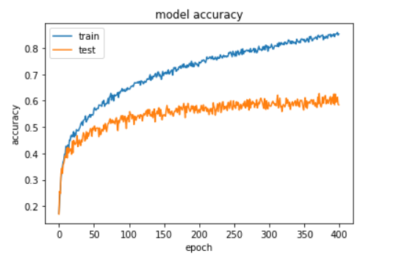
Model Accuracy
Actual Values Vs Predicted Values

Slide 12
ADVANTAGES
Irrespective of the speaker’s language, our model can detect the emotion in it.
Our model can work under extreme environmental conditions for example temperature, high humidity and bright light.
Improves human and machine communication.
Our model is accurate compared to the pre existing models which use lexical and feature extractions.

Slide 13
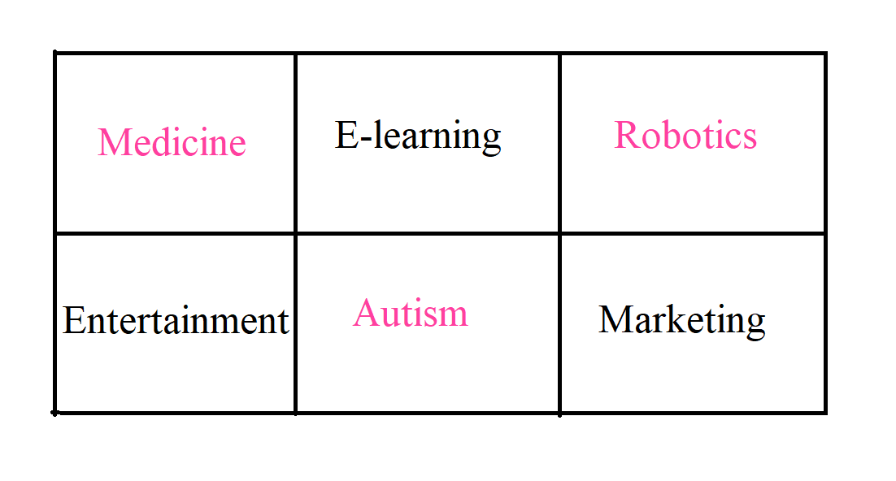
APPLICATIONS

Slide 14
FUTURE SCOPE
In the current social context, more and more people are already addicted to intelligent devices, and many of them already have an increasing tendency to interact with intelligent devices the same way they do with other human beings. This is the reason why the intelligent and empathetic device market has a spectacular development in the last few years. Estimates for the coming years are quite daunting.

Slide 15


